Slide 1

Halotechnics Renewable Energy Storage
Dr. Justin Raade, CEO and Founder
jraade@halotechnics.com
October 16, 2013
www.halotechnics.com

Slide 2
Our pitch in 3 steps
Renewable energy needs big storage – 12,000 megawatts in California alone
Halotechnics has the solution – We store electricity as heat, partnering with Shell
We’re offering you a great deal to get involved – Raising $500k notes with $2.25M cap

Slide 3
Renewable energy needs electricity storage
12,000 MW of storage is needed in California alone
46,000
44,000
From Storage
42,000
40,000
38,000
36,000
12,000 MW
34,000
32,000
30,000
28,000
26,000
24,000
Electricity
Demand (MW)
Demand minus solar and wind
22,000
20,000
0:00
1:30
3:00
4:30
6:00
7:30
9:00
10:30
12:00
13:30
15:00
16:30
18:00
19:30
21:00
22:30
0:00
Time of Day

Slide 4
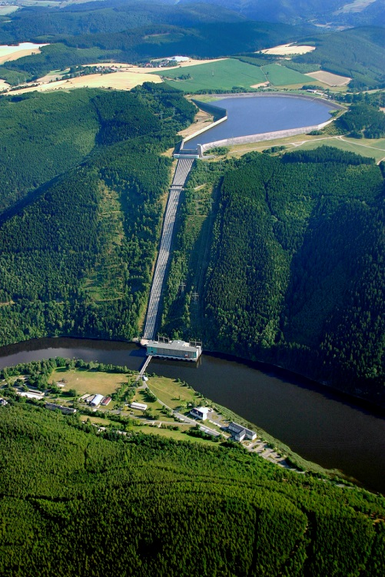
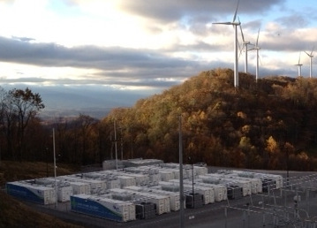
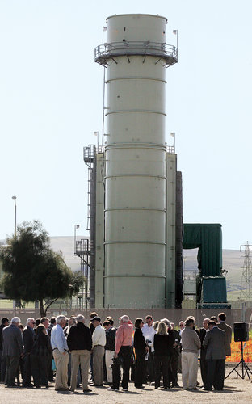
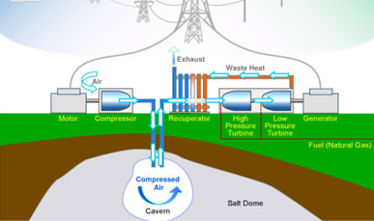
Our competition cannot meet the need
Batteries –
too expensive
Natural gas plants – CO₂, NO_{x} pollution
Pumped hydro – can’t site it
Compressed air –
can’t site it

Slide 5

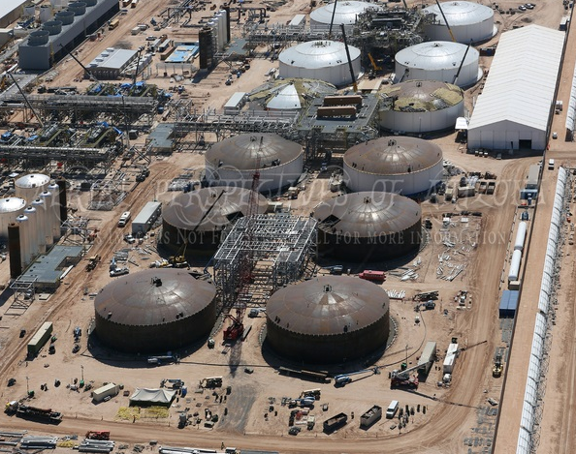
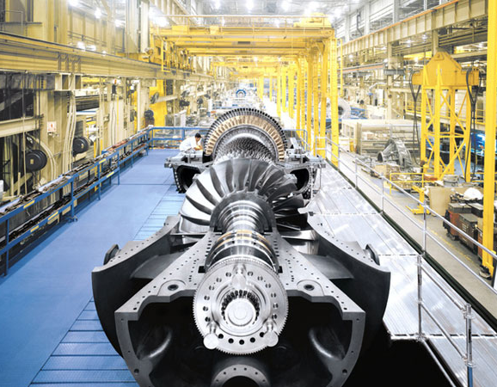
Halotechnics thermal electricity storage
Safe, reliable grid scale storage at a fraction of the cost of batteries
Stores electricity as heat in stable, abundant fluid
Capital cost as low as $150/kWh
Up to 70% round trip efficiency, 30 year lifetime
Scalable electricity storage
Molten salt storage
+
Proven turbo-machinery
=
Notes:
Novel system architecture, with each key component utilizing proven technology.

Slide 6



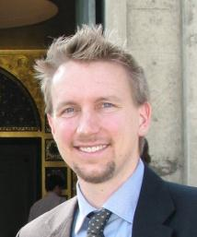

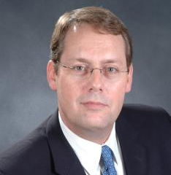

Company profile of Halotechnics, Inc.
We believe storage is the key to abundant clean energy
Founded 2009. $6.5 million in federal grants to date. Non-dilutive capital
Management team with power plant design and financing experience
Justin Raade, CEO, Founder
PhD in energy storage systems
Milt Venetos, Systems Eng.
GE alum, turbo-machinery guru
John Huffaker, Corporate Dev.
Key role in $1.8 billion energy deals
Grady Hannah, Business Dev.
Technology sales veteran

Slide 7
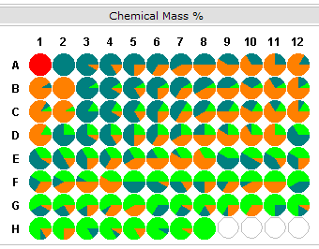
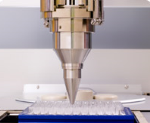
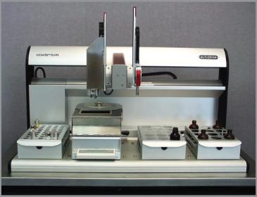
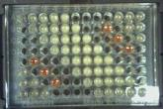
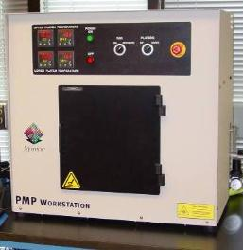
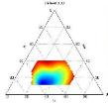
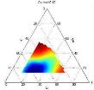
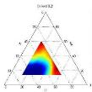
IP provides barrier to entry
Proprietary fluids and systems for high temperature energy storage
12 patent applications filed to date
Screened over 22,000 salt mixtures

Slide 8


Real traction from strategic partners
Leading power equipment company
#1 on Fortune Global 500
$1 million commercial project for pilot plant design
Wants storage for energy trading
Pathway for larger investment deals
$205k collaborative project for molten salt development
Interest in energy storage applications
Strategic turbine vendor

Slide 9
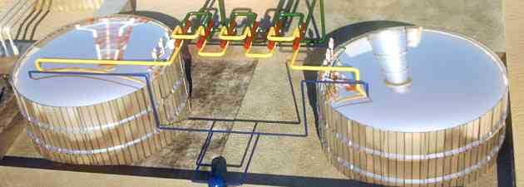
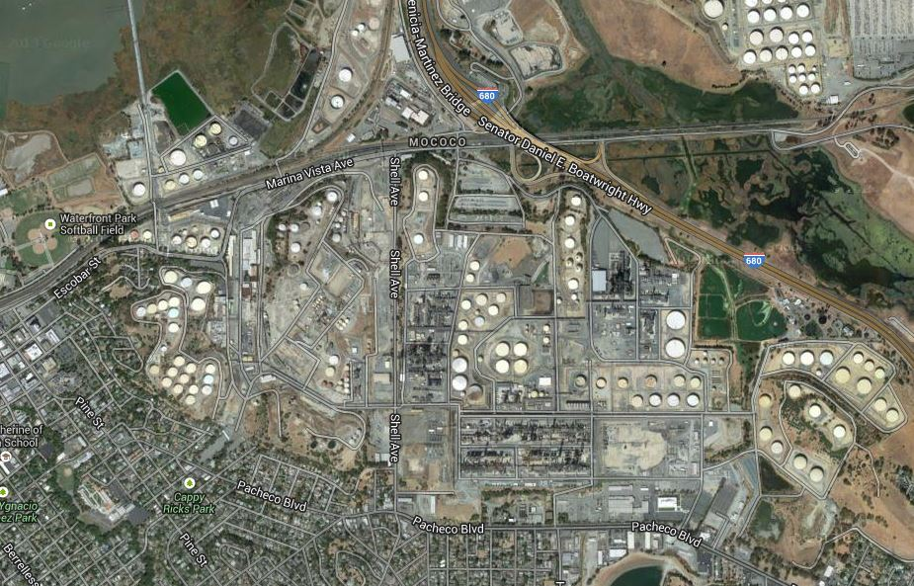
Renewable energy storage pilot plant
Sal Caliente Storage Plant
1 MW, 4 hours storage
Prospective location at Shell refinery in Martinez, California
Item | Description
Operation profile | Charge at night, discharge in afternoon
Storage | 100 tons molten salt energy storage
Off-taker | Shell Energy North America
Capital cost | $8 million (estimated)
Commissioning | October 2015

Slide 10
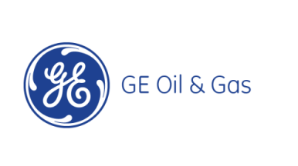



Strategic partners as acquirers
Turbo Machinery
Design and Engineering
Site and Off-Taker
Equity and Debt
Grants
Project Develop-ment
Project Owner
Recent $70 million acquisition of tidal energy startup!
Sal Caliente
Building strategic relationships, natural platform for acquisition

Slide 11
One and done financing strategy
1.
2.
3.
Design
Deploy
Op &
Shop
$500k seed round
$5 million Series A
Operate pilot plant
Lucrative acquisition
2013
2014
2015
2016
2017
Demonstrate technology and exit by acquisition in 36 months with <$6 million in dilutive financing.

Slide 12
Our pitch in 3 steps
Renewable energy needs big storage – 12,000 megawatts in California alone
Halotechnics has the solution – We store electricity as heat, partnering with Shell
We’re offering you a great deal to get involved – Raising $500k notes with $2.25M cap

Slide 13
Extra slides

Slide 14
Reverse heat engine electricity storage
RHEES
Efficient electricity storage enabled by Halotechnics thermal storage technology
Grid scale storage that’s cheaper than peakers
70% round trip efficiency, $150/kWh capital cost (compare to batteries at $500+/kWh)
Scalable to hundreds of megawatts!
565 °C
290 °C
High Quality Heat Stored
Saltstream
storage
Electricity In
Motor
compress
expand
Cold heat exchanger
Low Grade Heat In
The hotter, the better…

Slide 15
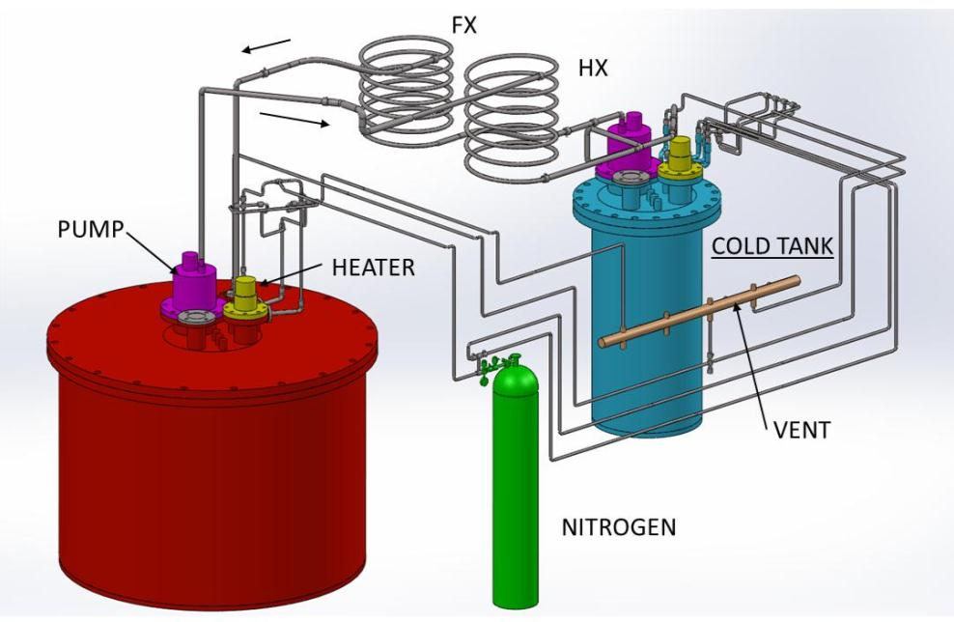
Thermal storage system engineering
5 kW
5 kW
HOT TANK
Pilot scale 700 °C thermal storage system complete (30 kWh, 300 kg salt)
Funded by $1 million NREL SunShot Incubator award
Notes:
Halotechnics is developing the complete engineering solutions for thermal storage systems in addition to the materials science development of the fluids

Slide 16
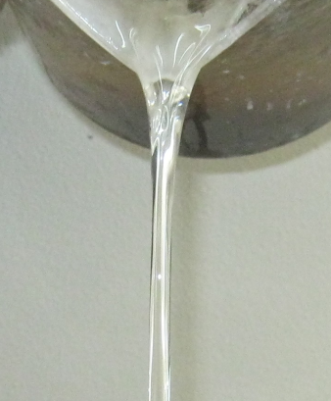
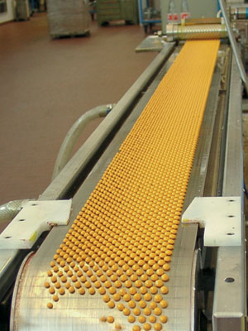
SaltstreamTM
Broad product range of Saltstream nitrate and chloride salts
Low-melting point, yet stable to high temperatures
Halotechnics has capability to deliver orders up to 1 metric ton
Scalable manufacturing process for larger orders
Saltstream 700
FLiNaK
60/40 solar salt
200
300
400
500
600
700
°C
Pastillation
Low melting point, stable fluids for applications from 50°C – 700 °C

Slide 17
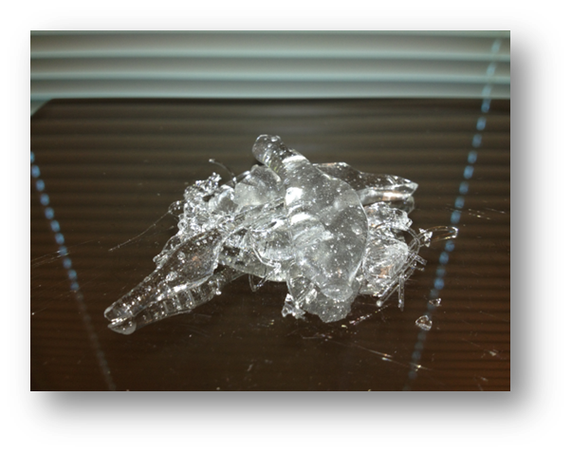
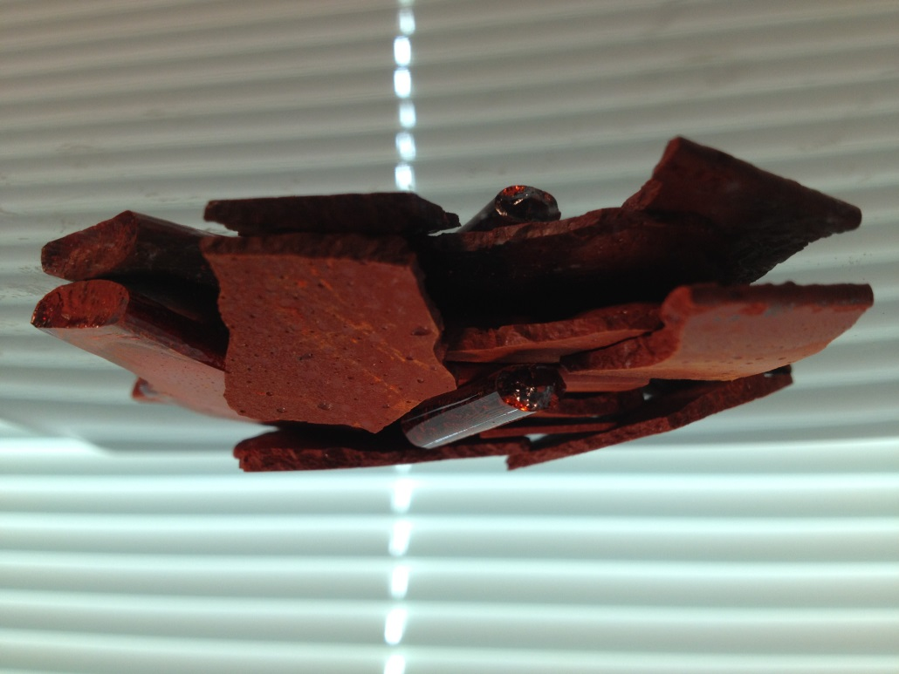
HaloglassTM
Haloglass RX
Haloglass CK
Low viscosity, high heat capacity fluids for applications exceeding 1000 °C

